Slide 1
Core Java

Slide 2
Collections

Slide 3

High-level, class-based, object-oriented programming language

Slide 4
Topics
1
5
Understanding Collection Framework
ArrayList
2
6
HashMap
ArrayLMap Interface
3
Iterator
4
List Interface

Slide 5
The hashCode() Contract
Whenever it is invoked on the same object more than once during an execution of a Java application, the hashCode() method must consistently return the same integer, provided no information used in equals() comparisons on the object is modified.
This integer need not remain consistent from one execution of an application to another execution of the same application.

Slide 6
The hashCode() Contract
It is NOT required that if two objects are unequal according to the equals(java.lang.Object) method, then calling the hashCode() method on each of the two objects must produce distinct integer results.
However, the programmer should be aware that producing distinct integer results for unequal objects may improve the performance of hashtables.
If two objects are equal according to the equals(Object) method, then calling the hashCode() method on each of the two objects must produce the same integer result.

Slide 7
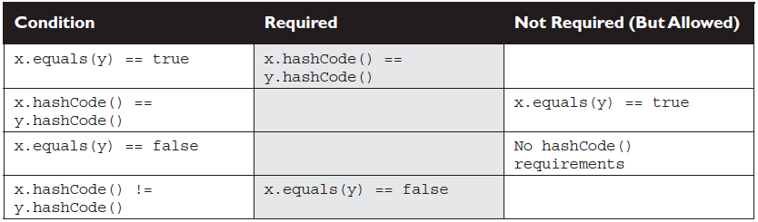
HashCode() and Equal() Contracts:

Slide 8
The equals() Contract
It is reflexive. For any reference value x, x.equals(x) should return true.
It is symmetric. For any reference values x and y, x.equals(y) should
return true if and only if y.equals(x) returns true.
It is transitive. For any reference values x, y, and z, if x.equals(y) returns
true and y.equals(z) returns true, then x.equals(z) must return true.

Slide 9
The equals() Contract
It is consistent. For any reference values x and y, multiple invocations of.
x.equals(y) consistently return true or consistently return false, provided
no information used in equals comparisons on the object is modified.
For any non-null reference value x, x.equals(null) should return false.

Slide 10
Understanding Collection Frameworks
The Java collections framework is a set of generic types that you use to create collection classes that support various ways for you to store and manage objects of any kind in memory.
An object of type ArrayList<T> represented an example of a collection of objects of type T, where T could be any class or interface type as long as the type met the conditions required by the collection.
For instance, to create an ArrayList that works with String, you pass String in angle brackets.
List<String> myList = new ArrayList<String>();

Slide 11
Java ArrayList
The ArrayList class is a resizable array, which can be found in the java.util package.
The difference between a built-in array and an ArrayList in Java, is that the size of an array cannot be modified. While elements can be added and removed from an ArrayList whenever you want.
Create an ArrayList object called cars that will store strings:
import java.util.ArrayList; // import the ArrayList class
ArrayList<String> cars = new ArrayList<String>(); // Create an ArrayList object

Slide 12
Add Items in ArrayList
To add elements to the ArrayList, use the add() method
import java.util.ArrayList;
public class Main {
public static void main(String[] args) {
ArrayList<String> cars = new ArrayList<String>();
cars.add("Volvo");
cars.add("BMW");
cars.add("Ford");
cars.add("Mazda");
System.out.println(cars);
}
}

Slide 13
Access, Change & Remove an Item in ArrayList
To access an element in the ArrayList, use the get() method and refer to the index number:
cars.get(0);
To change an element, use the set() method and refer to the index number:
cars.set(0, "Opel");
To remove an element, use the remove() method and refer to the index number:
cars.remove(0);

Slide 14
Sort an ArrayList
Sort an ArrayList of Strings:
public class Main {
public static void main(String[] args) {
ArrayList<String> cars = new ArrayList<String>();
cars.add("Volvo");
cars.add("BMW");
cars.add("Ford");
cars.add("Mazda");
Collections.sort(cars); // Sort cars
for (String i : cars) {
System.out.println(i);
}
}
}

Slide 15
Sort an ArrayList
Sort an ArrayList of Integers:
public class Main {
public static void main(String[] args) {
ArrayList<Integer> myNumbers = new ArrayList<Integer>();
myNumbers.add(33);
myNumbers.add(15);
myNumbers.add(20);
myNumbers.add(34);
myNumbers.add(8);
myNumbers.add(12);
Collections.sort(myNumbers); // Sort myNumbers
for (int i : myNumbers) {
System.out.println(i);}
}
}

Slide 16
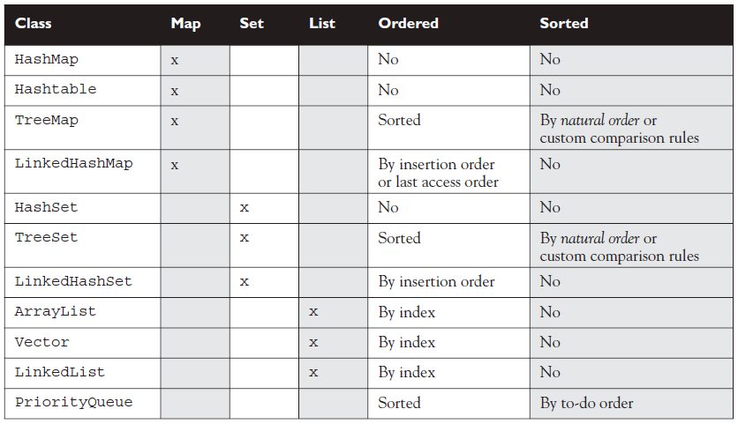
Behaviours at a Glance

Slide 17
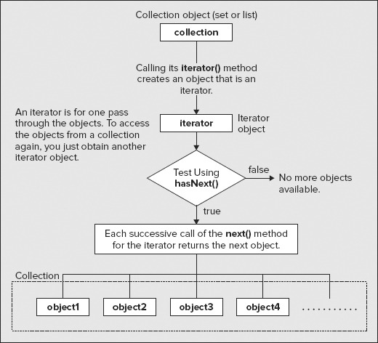
Iterators
An iterator is an object that you can use once to retrieve all the objects in a collection one by one.
Someone dealing cards from a deck one by one is acting as an iterator for the card deck
MyClass item;
while(iter.hasNext()) {
item = iter.next();
// Do something with item...
}

Slide 18
List Interface
A List is an ordered Collection (sometimes called a sequence). Lists may contain duplicate elements. In addition to the operations inherited from Collection, the List interface includes operations for the following:
Positional access — manipulates elements based on their numerical position in the list
Search — searches for a specified object in the list and returns its numerical position
Iteration — extends Iterator semantics to take advantage of the list's sequential nature
Range-view — performs arbitrary range operations on the list.

Slide 19
List Interface
public interface List<E> extends Collection<E> {
// Positional access
E get(int index);
// optional
E set(int index, E element);
// optional
boolean add(E element);
// optional
void add(int index, E element);
// optional
E remove(int index);
// optional
boolean addAll(int index, Collection<? extends E> c);
// Search
int indexOf(Object o);
int lastIndexOf(Object o);
// Iteration
ListIterator<E> listIterator();
ListIterator<E> listIterator(int index);
// Range-view
List<E> subList(int from, int to);
}

Slide 20
Common List Operations
Retrieving Item from arrayList in a loop
for(String item: stringList){ System.out.println("retrieved element: " + item);
Checking if ArrayList is Empty
boolean result = stringList.isEmpty(); //isEmpty() will return true if List is empty if(stringList.size() == 0){ System.out.println("ArrayList is empty"); }
Checking size of ArrayList
int size = stringList.size();
Checking Index of an Item in Java Arraylist
int index = stringList.indexOf("Item"); //location of Item object in List

Slide 21
Common List Operations
Copying data from one ArrayList to another ArrayList in Java
ArrayList<String> copyOfStringList = new ArrayList<String>(); copyOfStringList.addAll(stringList);
Replacing an element at a particular index
stringList.set(0,"Item2");
Clearing all data from ArrayList
stingList.clear();
Traversing in ArrayList in Java
Iterator itr = stringList.iterator(); while(itr.hasNext()){ System.out.println(itr.next()); } ListIterator listItr = stringList.listIterator(); while(listItr.hasNext()){ System.out.println(itr.next()); } }

Slide 22
Map Interface
The map interface, which is included in the javautil package, represents a mapping between a key and a value. The Map interface is not a subclass of the Collection interface.
As a result, it operates slightly differently from the other collection types. A map has unique keys
A Map is an object that maps keys to values.
A map cannot contain duplicate keys: Each key can map to at most one value.
It models the mathematical function abstraction.

Slide 23
Map Interface
public interface Map<K,V> {
// Basic operations
V put(K key, V value);
V get(Object key);
V remove(Object key);
boolean containsKey(Object key);
boolean containsValue(Object value);
int size();
boolean isEmpty();
// Bulk operations
void putAll(Map<? extends K, ? extends V> m);
void clear();
// Collection Views
public Set<K> keySet();
public Collection<V> values();
public Set<Map.Entry<K,V>> entrySet();
// Interface for entrySet elements
public interface Entry {
K getKey();
V getValue();
V setValue(V value);
}
}

Slide 24
Map Interface Basic Operations
import java.util.*;
public class Freq {
public static void main(String[] args) {
Map<String, Integer> m = new HashMap<String, Integer>();
// Initialize frequency table from command line
for (String a : args) {
Integer freq = m.get(a);
m.put(a, (freq == null) ? 1 : freq + 1);
}
System.out.println(m.size() + " distinct words:");
System.out.println(m);
}
}
This program generates a frequency table of the words found in its argument list.
The frequency table maps each word to the number of times it occurs in the argument list.

Slide 25
Map Interface Basic Operations
The only tricky thing about the previous program is the second argument of the put statement.
That argument is a conditional expression that has the effect of setting the frequency to one if the word has never been seen before or one more than its current value if the word has already been seen.
Try running that program with the command:
java Freq if it is to be it is up to me to delegate

Slide 26
Map Interface Iteration Operation
import java.util.HashMap;
import java.util.Iterator;
import java.util.Map;
import java.util.Set;
public class MapExample {
public static void main(String[] args) {
Map<Object,String> mp=new HashMap<Object, String>();
// adding or set elements in Map by put method key and value pair
mp.put(new Integer(2), "Two");
mp.put(new Integer(1), "One");
mp.put(new Integer(3), "Three");
mp.put(new Integer(4), "Four");
//Get Map in Set interface to get key and value
Set s=mp.entrySet();
//Move next key and value of Map by iterator
Iterator it=s.iterator();
while(it.hasNext())
{
// key=value separator this by Map.Entry to get key and value
Map.Entry m =(Map.Entry)it.next();
// getKey is used to get key of Map
int key=(Integer)m.getKey();
// getValue is used to get value of key in Map
String value=(String)m.getValue();
System.out.println("Key :"+key+" Value :"+value);
}
}
}

Slide 27
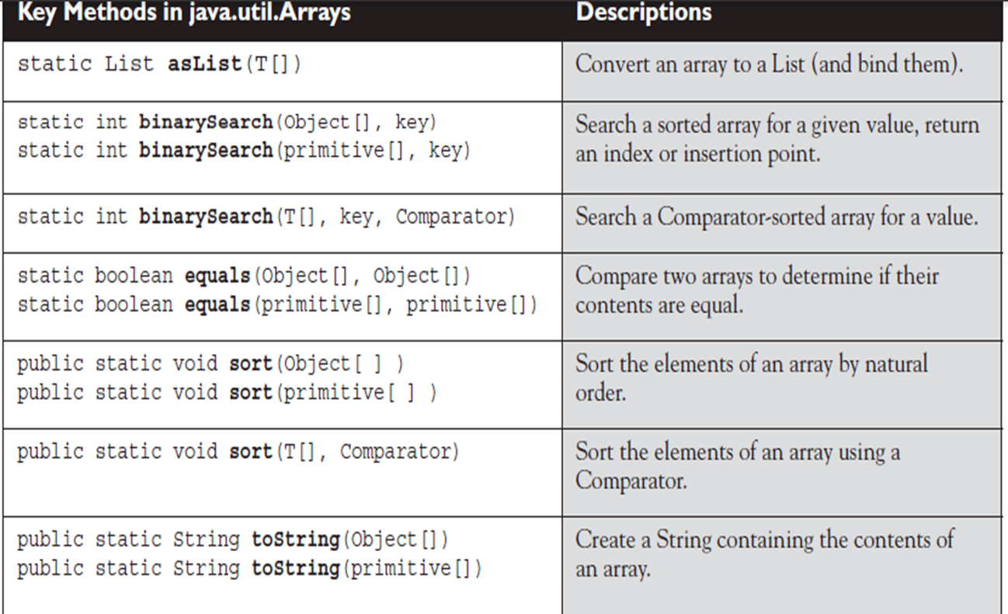
Arrays

Slide 28
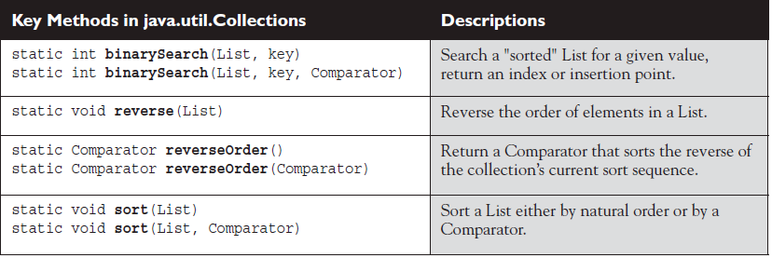
Collections

Slide 29
Exercises
Write a java class to sort list of objects using comparator and sort method . {Account(id, email, balance, name, phone)}
Write a class to find frequency of names for a given list of student's object. {Student (id, name, class, rollNo)}

Slide 30
Thank You

